Slide 1
Chapter 9 Virtual Memory

Slide 2
教学内容、目标与要求
教学内容
虚拟存储概念
请求页式管理
页面置换
帧分配
抖动
内核空间分配
其他事项
教学重点与难点
重点：2、3
难点：3、5、6
教学目标与要求
理解虚拟内存系统的优点；
了解按需调页的概念；
掌握页面置换算法和帧分配方法；
理解抖动现象及工作集模型。

Slide 3
Contents
9.1 Background
9.2 Demand Paging
9.3 Copy-on-write
9.4 Page Replacement
9.5 Allocation of Frames
9.6 Thrashing
9.7 Memory-mapped file
9.8 Allocating Kernel Memory
9.9 Other considerations
9.10 Operating-System Examples

Slide 4
9.1 Background
Code needs to be in memory to execute, but entire program rarely used.
Error code, unusual routines, large data structures.
Entire program code not needed at same time.
Consider ability to execute partially-loaded program.
Program no longer constrained by limits of physical memory.
Each program takes less memory while running, more programs run at the same time.
Increased CPU utilization and throughput with no increase in response time or turnaround time.
Less I/O needed to load or swap programs into memory, each user program runs faster.

Slide 5
Background
Virtual memory – separation of user logical memory from physical memory.
Only part of the program needs to be in memory for execution.
Logical address space can be much larger than physical address space.
Allows address spaces to be shared by several processes.
Allows for more efficient process creation.
More programs running concurrently.
Less I/O needed to load or swap processes.
按需分配
空间共享
提高效率

Slide 6
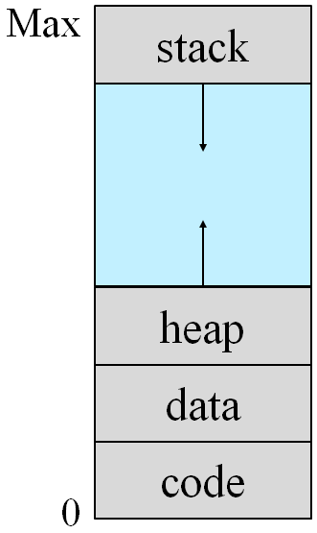
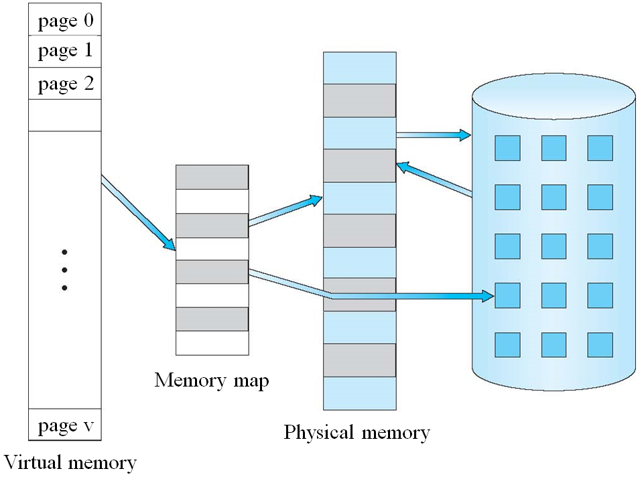
Virtual-address Space
logical view of how process is stored in memory.
Start at address 0, contiguous addresses until end of space.
Physical memory organized in page frames.
MMU must map logical to physical.
Can be larger than physical memory.

Slide 7
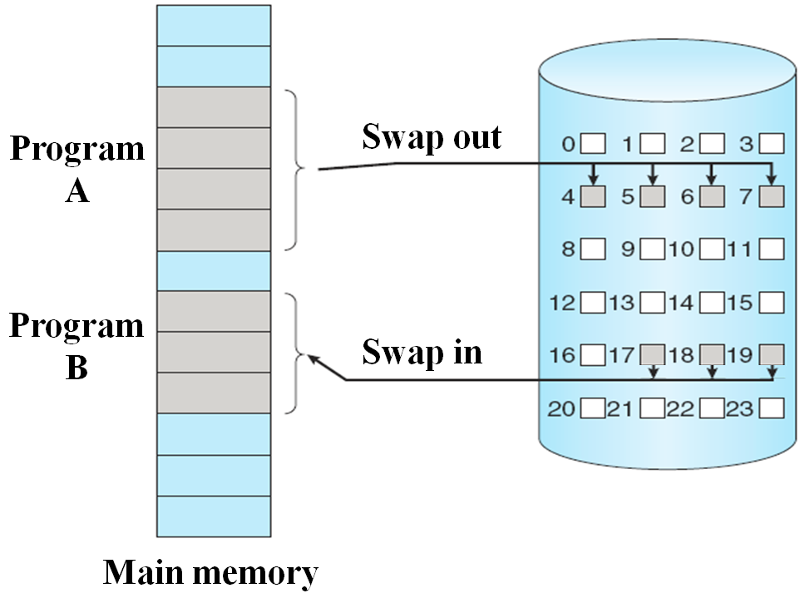
Background
Virtual memory can be implemented via:
Demand paging
Demand segmentation
a paging system with swapping
Swapper manipulates entire processes
Bring a page into memory only when it is needed.
Pager deals with the individual pages of a process

Slide 8
9.2 Demand Paging
Lazy swapper: never swaps a page into memory unless that page will be needed.
Page is needed ⇒ reference to it.
If pages needed are already memory resident
No difference from non demand-paging.
If pages needed and not memory resident
Need to detect
Invalid reference ⇒ abort.
Valid address but not-in-memory ⇒ bring it into memory.
Without changing program behavior.
Without programmer needing to change code.

Slide 9
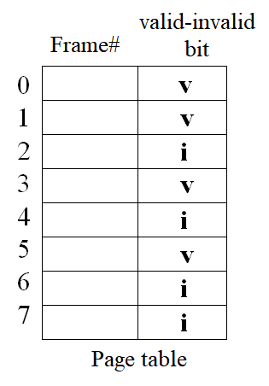
Valid-Invalid Bit
With each page table entry a valid–invalid bit is associated.
v ⇒ valid & in-memory,
i ⇒ invalid or valid but not-in-memory
Initially valid–invalid bit is set to "i" on all entries.
When a page is loaded into a frame, the frame# is written into the page-table entry, and set the Valid-Invalid bit to "v".
During address translation, if valid–invalid bit in page table entry is i ⇒ page fault（缺页）.

Slide 10
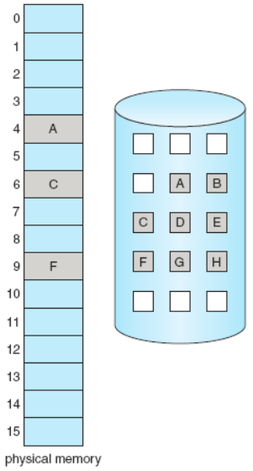
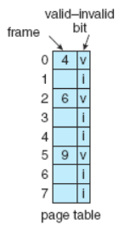

Page Table When Some Pages Not in Memory

Slide 11
Steps in Handling a Page Fault
If there is a reference to a page, first reference to that page will trap to OS ⇒ page fault.
OS looks at another internal table (kept with PCB, page#-block#) to decide:
Invalid reference ⇒ abort.
Valid, just not in memory ⇒ page it in.
Find a free frame.
Read page into frame via scheduled disk operation.
Reset page table, writes frame#, Set validation bit="v".
Restart the instruction that caused the page fault.

Slide 12
Steps in Handling a Page Fault
OS
3 page is on backing store
ADD A, B, C
A
缺页中断
2 trap
B
1 reference
C
load M
F#
v
i
6 restart
instruction
page table
Free frame
5 reset page table
4 bring in
missing page
e.g.
A+B ⇒ C
按需分配
Pure demand paging
physical memory

Slide 13
Aspects of Demand Paging
Pure demand paging, an extreme case, start process with no pages in memory.
OS sets instruction pointer to the first instruction of process, non-memory-resident ⇒ page fault.
And for every other process pages on first access.
Actually, a given instruction could access multiple pages ⇒ multiple page faults.
Consider fetch and decode of instruction which adds 2 numbers from memory and stores result back to memory. A+B==>C
Pain decreased because of locality of reference.
Hardware support needed for demand paging.
Page table with valid-Invalid bit.
Secondary memory (swap device with swap space)
Instruction restart.

Slide 14
What happens if there is no free frame?
Page replacement find some page in memory, but not really in use, swap it out.
Page replacement algorithm
Algorithm?
Performance?
want an algorithm which will result in minimum number of page faults.
Same pages may be brought into memory several times.

Slide 15
Stages in Demand Paging (worse case)
Trap to the OS.
Save the user registers and process state.
Determine that the interrupt was a page fault.
Check that the page reference was legal and determine the location of the page on the disk.
Issue a read from the disk to a free frame:
Wait in a queue for this device until the read request is serviced.
Wait for the device seek and/or latency time.
Begin the transfer of the page to a free frame.
While waiting, allocate the CPU to some other user.
Receive an interrupt from the disk I/O subsystem (I/O completed).
Save the registers and process state for the other user.
Determine that the interrupt was from the disk.
Correct the page table and other tables to show page is now in memory.
Ready, wait for the CPU to be allocated to this process again.
Restore the user registers, process state, and new page table, and then resume the interrupted instruction.

Slide 16
Performance of Demand Paging
Page Fault Rate 0 ≤ p ≤ 1.0
if p = 0, no page faults
if p = 1, every reference is a fault
Effective Access Time (EAT)
EAT = (1– p) × memory access time + p × page fault service time
Three major activities
Service the page fault interrupt, careful coding means just several hundred instructions needed.
Read in the page, lots of time.
Restart the process, again just a small amount of time.
page fault service time = page fault overhead
+ [ swap page out ]
+ swap page in
+ restart overhead
1~100 μs
8ms=5+3+0.05
seek
latency
transfer

Slide 17
Demand Paging Example
Memory access time = 200 nanoseconds
Effective Access Time
EAT = (1 – p) × 200 + p × (8 000 000) = 200 + 7 999 800 × p
If one access out of 1,000 causes a page fault,
P=0.001
EAT=8199.8ns
Slowed down by a factor of 40
If want performance degradation < 10%
200 + 7,999,800 * p < 220 7,999,800 * p < 20
p < 0.0000025
< 1 page fault in every 400,000 memory accesses.

Slide 18
Exercise 1
On a system using paging, references to a swapped-in locations accessible through an entry in an associative table (TLB) take 150ns. If the main memory page table must be used, the reference takes 400ns. References that result in page faults require 8ms if the page to be replaced has been modified, 3ms otherwise. If the page fault rate is 2%, the associative table(TLB) hit rate is 70%, and 50% of replaced pages have been modified, what is the effective access time? Assume the system is running only a single process and the CPU is idle during page swaps.
EAT =
1s=1000ms 1ms=1000µs 1µs=1000ns 1ns=1000ps

Slide 19
Exercise 2
Assume that we have a demand-paged memory. The page table is held in registers. It takes 8 milliseconds to service a page fault if an empty frame is available or if the replaced page is not modified and 20 milliseconds if the replaced page is modified. Memory-access time is 100 nanoseconds. Assume that the page to be replaced is modified 30 percent of the time. What is the maximum acceptable page-fault rate for an effective access time of no more than 200 nanoseconds?
P ≤
1s=1000ms 1ms=1000µs 1µs=1000ns 1ns=1000ps

Slide 20
Exercise 3
Assume that a program has just referenced an address in virtual memory. Describe a scenario in which each of the following can occur. (If no such scenario can occur, explain why.)
TLB miss with no page fault
TLB miss and page fault
TLB hit and no page fault
TLB hit and page fault
Yes？ | No？
Yes？ | No？
Yes？ | No？
Yes？ | No？

Slide 21
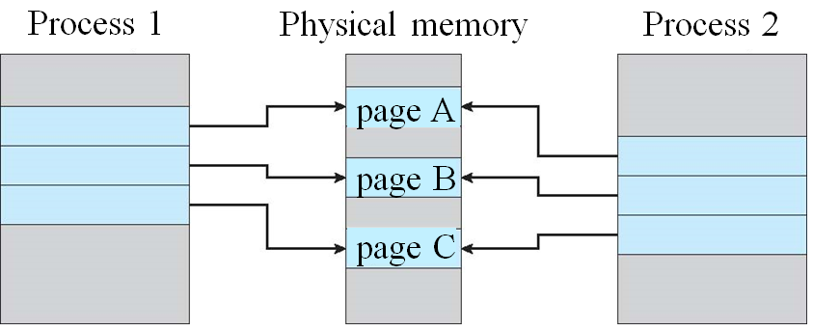
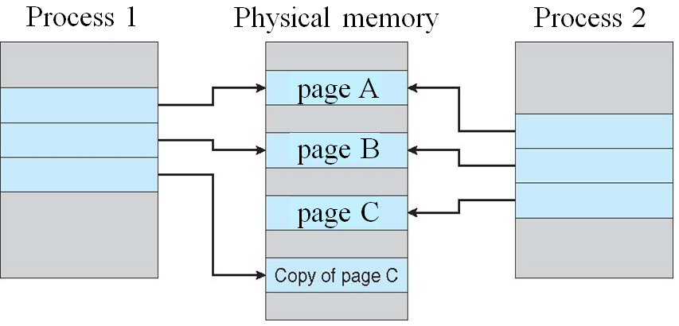
9.3 Copy-on-Write—process creation
Fork()
Copy-on-Write (COW) allows both parent and child processes to initially share the same pages in memory.
If either process modifies a shared page, only then is the page copied.
COW allows more efficient process creation as only modified pages are copied.
only pages that can be modified need be marked as copy-on-write.
A1：openEuler COW
空间共享，提高效率，提高内存利用率

Slide 22
COW，Copy-on-Write
In general, free pages are allocated from a pool of free pages.
Pool should always have free frames for fast demand page execution.
Using a technique known as zero-fill-on-demand. zero-out a page before allocating it. Erasing the previous contents.
vfork(), does not use copy-on-write. has parent suspend and child using the address space of parent.
If the child changes any pages of the parent's address space, the altered pages will be visible to the parent once it resumes.
Designed to have child call exec() immediately.
Very efficient method of process creation.
Sometimes used to implement UNIX command-line shell interface.
A2：vfork()

Slide 23
9.4 Page Replacement
Used up by process pages
Also in demand from the kernel, I/O buffers, etc.
How much to allocate to each?
Allocate a fixed percentage of memory for I/O buffers.
Allow both user processes and I/O subsystem to compete for all memory.
What happens if there is no free frame?
Terminate the user process. (not the best choice)
Swap processes?
Page replacement, demand paging, transparent to the user.

Slide 24
Need For Page Replacement
frame
valid-invalid bit
0
monitor
0
H
3 v
1
load M
1
M
PC
4 v
2
J
5 v
2
D
3
M
1 v
i
B
logical memory
for process 1
3
H
page table for process 1
4
load M
5
J
frame
valid-invalid bit
6
A
M
0
A
6 v
7
E
1
B
i
2
C
physical
memory
2 v
3
D
7 v
logical memory
for process 2
page table for process 2

Slide 25
Basic Page Replacement
Find the location of the desired page on disk.
Find a free frame:
If there is a free frame, use it.
If there is no free frame, use a page replacement algorithm to select a victim frame.
Write the victim frame to the disk if dirty; change the page and frame tables accordingly.
Read the desired page into the (newly) freed frame. Update the page and frame tables.
Continue the process by restarting the instruction that caused the trap.
Note now potentially 2 page transfers (1 out and 1 in) for page fault – increasing EAT.

Slide 26
Basic Page Replacement
Use modify bit (dirty bit) to reduce overhead of page transfers.
modify bit is needed to indicate if the page has been altered since it was last loaded into main memory.
only modified pages are written to disk.
Page replacement completes separation between logical memory and physical memory.
large virtual memory can be provided on a smaller physical memory.
With no demand paging, all the pages of a process still must be in physical memory.

Slide 27
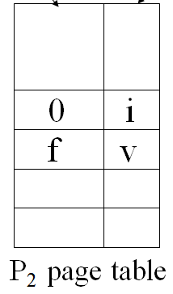
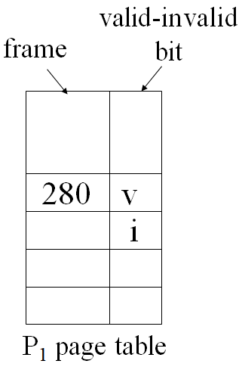
Page Replacement
global / local
replacement?
Modify bit?
i
change
to invalid
②
swap out
victim
page
①
f
victim
swap
desired
page in
③
reset page
table for
new process
f v
④
Physical memory

Slide 28
Page and Frame Replacement Algorithms
Frame-allocation algorithm determines
How many frames to give each process?
Which frames to replace, when page fault?
Page-replacement algorithm
Want lowest page-fault rate on both first access and re-access.
Page removed should be the page least likely to be referenced in the near future.
want an algorithm which will result in minimum number of page faults.
Evaluate algorithm by running it on a particular string of memory references (reference string) and computing the number of page faults on that string.
reference string is just page numbers, not full addresses.
Repeated access to the same page does not cause a page fault.
Results depend on the number of frames available.

Slide 29
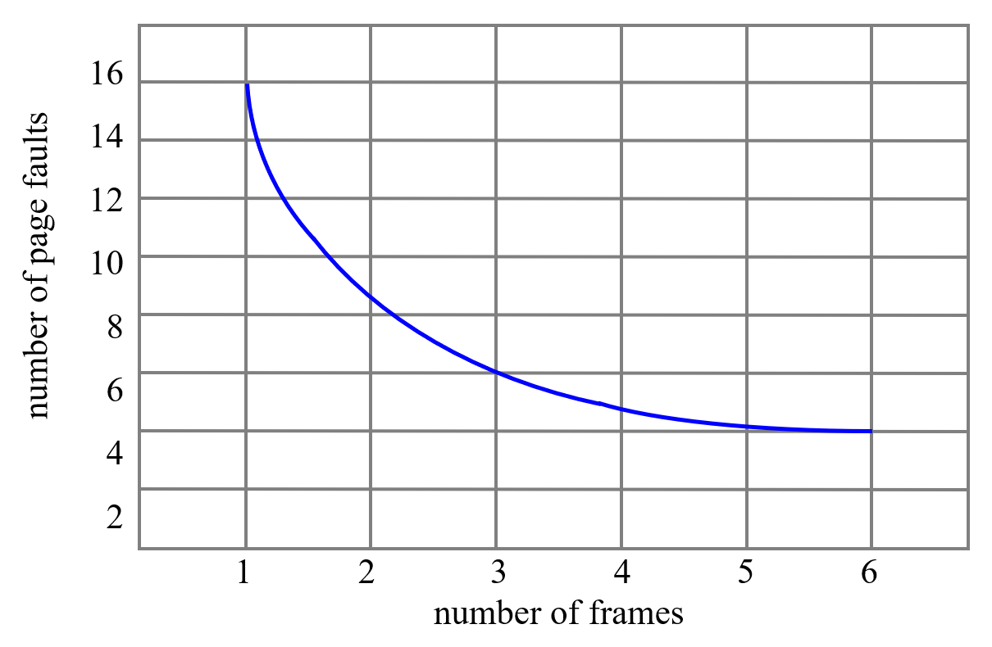
reference strings
We can generate reference strings
artificially by a random-number generator, or
by tracing a given system and record the address of each memory reference.
E.g. record the following address sequence:
0100, 0423, 0101, 0612, 0102, 0103, 0104, 0101, 0611, 0102, 0103, 0104, 0101, 0610, 0102, 0103, 0104, 0101, 0609, 0102, 0105
Page size is 100B, reduced to the following reference string: 1, 4, 1, 6, 1, 1, 1, 1, 6, 1, 1, 1, 1, 6, 1, 1, 1, 1, 6, 1, 1 1, 4, 1, 6, 1, 6, 1, 6, 1, 6, 1
In all our examples, the reference strings are
7, 0, 1, 2, 0, 3, 0, 4, 2, 3, 0, 3, 2, 1, 2, 0, 1, 7, 0, 1
1, 2, 3, 4, 1, 2, 5, 1, 2, 3, 4, 5

Slide 30
FIFO (First-In-First-Out) Algorithm
Associates with each page the time when it was brought into memory.
When a page must be replaced, the oldest page is chosen.
Example
3 frames (3 pages can be in memory at a time per process)
7 0 1 2 0 3 0 4 2 3 0 3 2 1 2 0 1 7 0 1
pure demand paging
F1
F2
F3
*
7
*
7
*
7
2
2
4
4
4
0
0
0
7
7
7
2
*
*
*
*
0
0
0
3
3
3
2
2
2
1
1
1
0
0
*
*
*
*
1
1
1
0
0
0
3
3
3
2
2
2
1
*
*
*
*
How to track ages of pages?
Just use a FIFO queue to hold all pages in memory.
Treats frames allocated to a process as a circular buffer.
Pages are removed in round-robin style.
The page replaced may be needed again very soon.

Slide 31
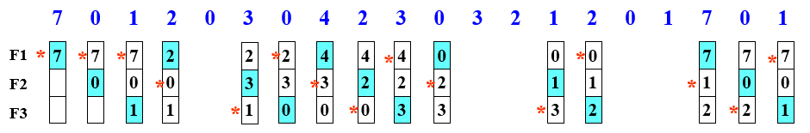
FIFO example*
FIFO queue
circular buffer, round-robin
7
0
1
2
3
0
F1
F2
F3
F1
F2
F3
F1
2
7
0
1
F2
3
0
F3

Slide 32
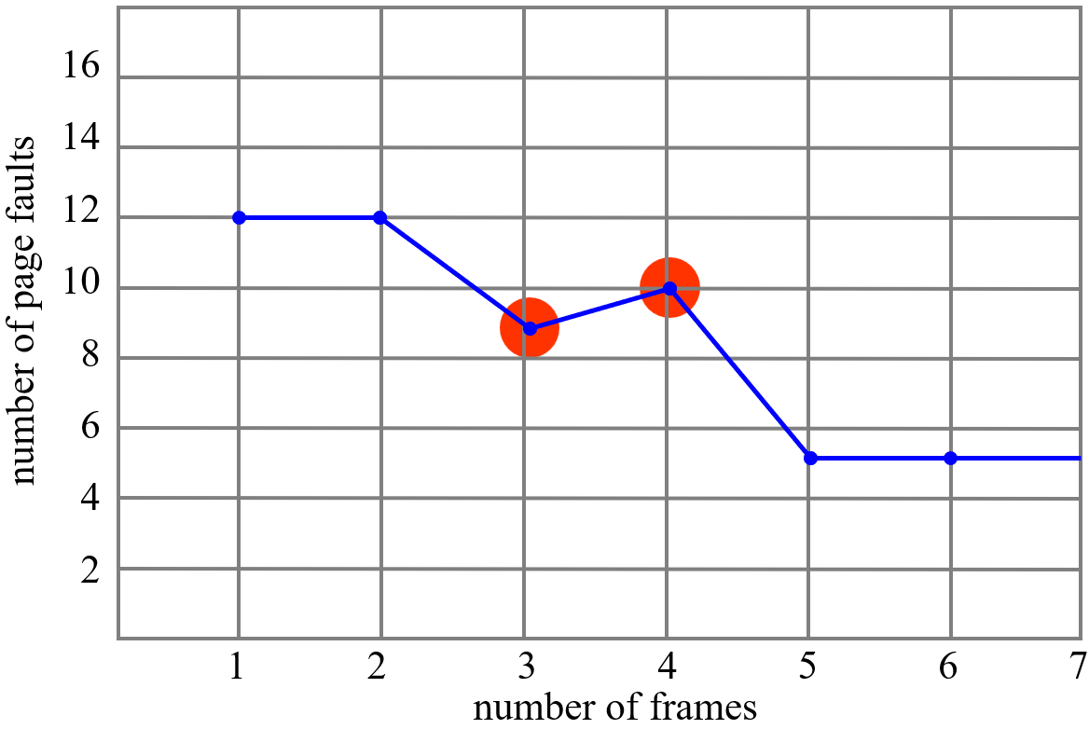
Belady’s Anomaly
more frames ⇒ more page faults
Reference string: 1, 2, 3, 4, 1, 2, 5, 1, 2, 3, 4, 5
3 frames
1 2 3 4 1 2 5 1 2 3 4 5
4 frames
1 2 3 4 1 2 5 1 2 3 4 5
1
1
1
4
4
4
5
5
5
9 times page fault
Page fault rate：
9/12=75%
-
2
2
2
1
1
1
3
3
-
-
3
3
3
2
2
2
4
1
1
1
1
5
5
5
5
4
4
10 tmes page fault
Page fault rate：
10/12=83.3%
-
2
2
2
2
1
1
1
1
5
-
-
3
3
3
3
2
2
2
2
-
-
-
4
4
4
4
3
3
3

Slide 33
Optimal Algorithm
Replace the page that will not be used for the longest period of time.
3 frames example
7 0 1 2 0 3 0 4 2 3 0 3 2 1 2 0 1 7 0 1
F1
F2
F3
7
7
7
7
2
2
2
2
2
0
0
0
0
4
0
0
0
1
1
3
3
3
1
1
Only 9 page faults
OPT (or MIN) has the lowest page-fault rate of all algorithms, and never suffer from Belady's anomaly.

Slide 34
OPT Algorithm
理论最优，效率最高
标杆—衡量算法性能
for the OPT algorithm，the page-fault rate on S is the same as the page-fault rate on S^{R}.
1 0 7 1 0 2 1 2 3 0 3 2 4 0 3 0 2 1 0 7
F1
F2
F3
1
1
1
1
3
3
3
1
1
0
0
0
0
0
0
0
0
7
2
2
4
2
2
7
Requires future knowledge of the reference string.
Thinking about: How do you know the reference string?
Impossible to have perfect knowledge of future events.
Used mainly for comparison studies
measures how well your algorithm performs.

Slide 35
OPT Algorithm
Reference string: 1 2 3 4 1 2 5 1 2 3 4 5
3 frames
1 2 3 4 1 2 5 1 2 3 4 5
4 frames
1 2 3 4 1 2 5 1 2 3 4 5
1
1
1
1
1
3
3
7 times page fault
Page fault rate：
7/12=58.3%
-
2
2
2
2
2
4
-
-
3
4
5
5
5
1
1
1
1
1
4
6 times page fault
Page fault rate：
6/12=50%
-
2
2
2
2
2
-
-
3
3
3
3
-
-
-
4
5
5

Slide 36
Least Recently Used (LRU) Algorithm
replaces the page that has not been used for the longest period of time.
By the principle of locality, this should be the page least likely to be referenced in the near future.
Associates with each page the time of that page’s last use.
Example
7 0 1 2 0 3 0 4 2 3 0 3 2 1 2 0 1 7 0 1
7
7
7
2
2
4
4
4
0
1
1
1
0
0
0
0
0
0
3
3
3
0
0
1
1
3
3
2
2
2
2
2
7
1 0 7 1 0 2 1 2 3 0 3 2 4 0 3 0 2 1 0 7
1
1
1
1
1
0
4
4
4
2
2
7
0
0
0
3
3
3
0
0
0
0
0
7
2
2
2
2
2
3
3
1
1

Slide 37
LRU Algorithm example
Reference string: 1, 2, 3, 4, 1, 2, 5, 1, 2, 3, 4, 5
3 frames
1 2 3 4 1 2 5 1 2 3 4 5
4 frames
1 2 3 4 1 2 5 1 2 3 4 5
1
1
1
4
4
4
5
3
3
3
10 times page fault
Page fault rate：
10/12=83.3%
-
2
2
2
1
1
1
1
4
4
-
-
3
3
3
2
2
2
2
5
1
1
1
1
1
1
1
5
8 times page fault
Page fault rate ：
8/12=66.7%
-
2
2
2
2
2
2
2
-
-
3
3
5
5
4
4
-
-
-
4
4
3
3
3

Slide 38
Replacement Algorithms Summary
The FIFO algorithm uses the time when a page was brought into memory.
The oldest page is replaced.
The OPT algorithm uses the time when a page is to be used.
The page that will not be used for the longest period of time is replaced.
the LRU algorithm uses the time when a page was referenced last.
The page that has not been used for the longest period of time is replaced.
公平性
异常现象
理论最优
效率最高
标杆
实用
效率高

Slide 39
Exercise 4
Consider the following page reference string: 1, 2, 4, 5, 3, 4, 1, 6, 8, 7, 8, 9, 7, 8, 9, 5, 4, 5, 4, 2.
How many page faults would occur for the following replacement algorithms.
Assume there are three frames available, and all frames are initially empty.
(1) Optimal replacement
(2) LRU replacement
(3) FIFO replacement

Slide 40
Answer for exercise 4
OPT:
Page fault: 12 times, page fault rate: 12/20=0.6
 | 1 | 2 | 4 | 5 | 3 | 4 | 1 | 6 | 8 | 7 | 8 | 9 | 7 | 8 | 9 | 5 | 4 | 5 | 4 | 2
-
-
-
pagefault?
LRU:
Page fault: 13 times, page fault rate: 13/20=0.65
 | 1 | 2 | 4 | 5 | 3 | 4 | 1 | 6 | 8 | 7 | 8 | 9 | 7 | 8 | 9 | 5 | 4 | 5 | 4 | 2
-
-
-
pagefault?

Slide 41
Answer for exercise 4
FIFO:
Page fault: 13 times, page fault rate: 13/20=0.65
 | 1 | 2 | 4 | 5 | 3 | 4 | 1 | 6 | 8 | 7 | 8 | 9 | 7 | 8 | 9 | 5 | 4 | 5 | 4 | 2
-
-
-
pagefault?

Slide 42
LRU implementation
may require substantial hardware assistance.
Problem -- determine an order for the frames defined by the time of last use.
Counters
Every page entry has a counter, a time-of-use field; add to the CPU a logical clock or counter. The clock is incremented for every memory reference.
Every time a page is referenced through this entry, copy the contents of the clock into the time-of-use field in the page-table for that page.
When a page needs to be replaced, look at the counters to determine which are to be replaced.
Replace the page with the smallest time value.
P#
F#
counter

Slide 43
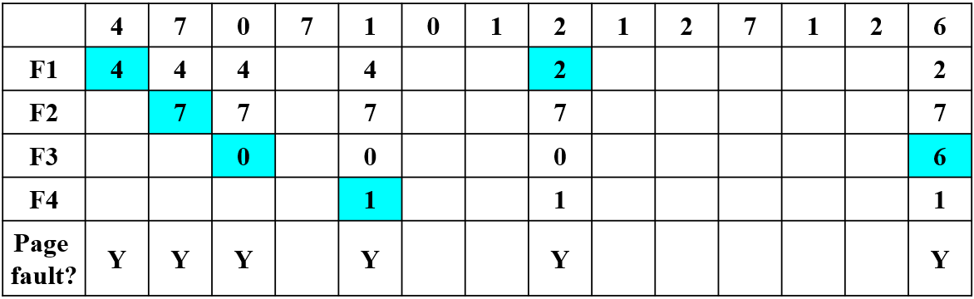
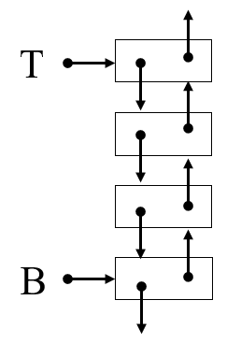
LRU implementation
Stack
keep a stack of page numbers in a double link form.
Page referenced: move it to the top
requires 6 pointers to be changed, at worst.
No search for replacement, LRU page is at the bottom.
example：4 frames
4 7 0 7 1 0 1 2 1 2 7 1 2 6
top
1 F4
0
1
2
7
2
6 F3
0 F3
7 F2
1
0
1
2
1
2 F1
7 F2
0 F3
7
7
0
1
7
1 F4
bottom
4 F1
4 F1
4
4
7
0
0
7 F2

Slide 44
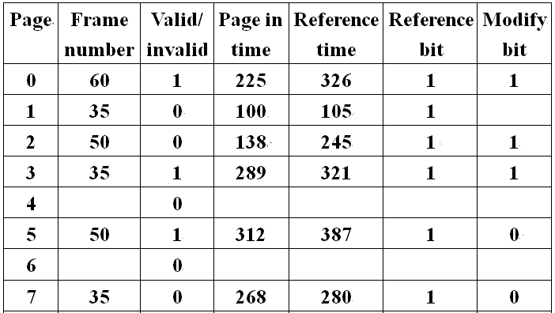
Exercise 5
A process has 8 pages, its page table is shown as above, assume three frames are allocated to this process.
Now page 6 is needed.
FIFO replacement algorithm is used, which frame will the page be paged into?
LRU replacement algorithm is used, which frame will the page be paged into?
Frame ? 60
Frame ? 35

Slide 45
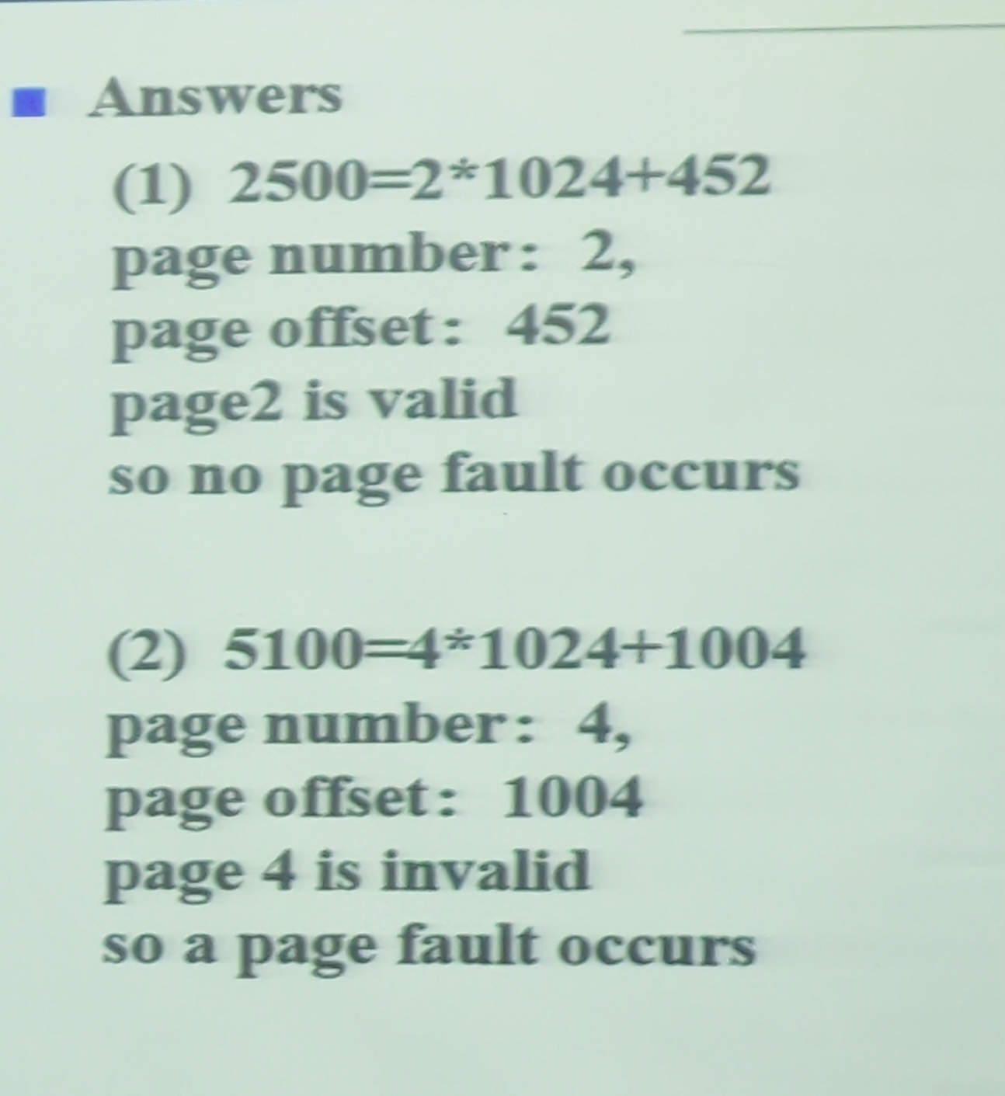
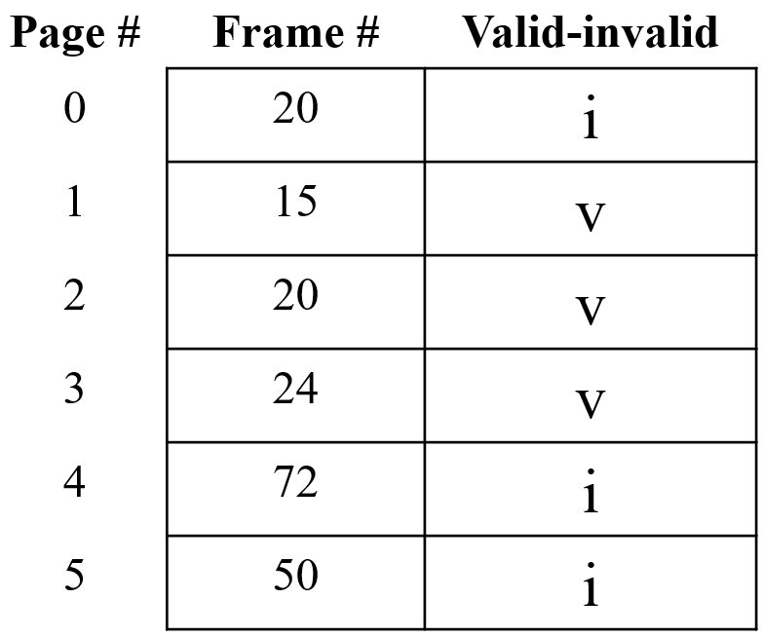
Exercise 6
In a demand paging system, the page size is 1024 bytes, and the page table of a process is as follows, would the following virtual addresses (assuming use decimal values) result in a page fault ? and why ?
(1) 2500
(2) 5100
Answers
(1)
(2)

Slide 46
LRU Approximation Algorithms
LRU needs special hardware and still slow.
Reference bit algorithm
With each page entry associate a bit, initially set to 0.
When page is referenced, the bit is set to 1 by the hardware.
Replace the one which is 0 (if one exists).
Problem：if all pages are referenced, we do not know the order.

Slide 47
LRU Approximation Algorithms
Additional-reference-bits algorithm
Keep an 8-bit byte for each page in a table in memory.
At regular intervals, a timer interrupts, OS shifts the reference bit for each page into the high-order bit of its 8-bit byte, shifting the other bits right by 1 bit and discarding the low-order bit.
These 8-bit byte contains the history of page use for the last 8 time periods.
The page with the lowest number is the LRU page, can be replaced.
1 00000000 / 0 11111111 ?
F# …
Ref. bit
History bits
……

Slide 48
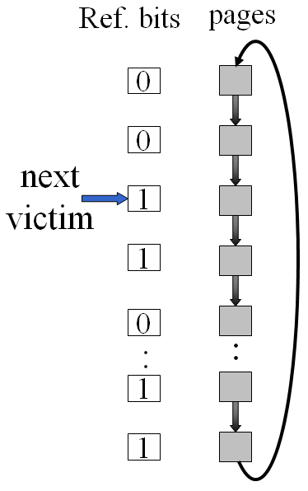
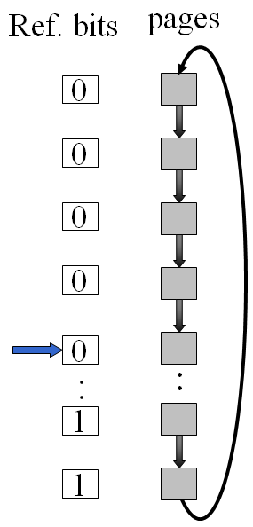
LRU Approximation Algorithms
Second chance
Basic algorithm: FIFO replacement algorithm.
Need reference bit
Clock replacement
If page to be replaced (in clock order) has reference bit = 1. then:
set its reference bit 0, its arrival time to the current time.
leave the page in memory.
replace next page (in clock order), subject to same rules.

Slide 49
LRU Approximation Algorithms
Enhanced Second-Chance Algorithm
Considering both the reference bit and the modify bit as an ordered pair (reference bit, modify bit).
Each page is in one of four classes:
(0,0) neither recently used nor modified -- best page to replace
(0,1) not recently used but modified -- the page will need to be written out before replacement.
(1,0) recently used but clean -- probably will be used again soon.
(1,1) recently used and modified -- probably will be used again soon, and the page will be need to be written out to disk before replacement.
Examine the class to which that page belongs.
Replace the first page encountered in the lowest non-empty class.
Might need to search circular queue several times.

Slide 50
LRU Approximation Algorithms
Counting-based page replacement
Keep a counter of the number of references that have been made to each page.
LFU Algorithm: Least Frequently Used
replaces page with the smallest count.
shift the counts right by 1 bit at regular intervals.
MFU Algorithm: Most Frequently Used
based on the argument that the page with the smallest count was probably just brought in and has yet to be used.
neither MPU nor LFU replacement is common.

Slide 51
Page-Buffering Algorithm
Keep a pool of free frames.
When a page fault occurs,
A victim frame is chosen as before.
The desired page is read into a free frame from the pool before the victim is written out.
When the victim is later written out, its frame is added to the free-frame pool.
Possibly, maintain a list of modified pages.
Whenever the paging device is idle, a modified page is selected and is written to the disk.
Its modify bit is then reset.
Possibly, keep a pool of free frames, but to remember which page was in each frame.
The old page can be reused directly from the free-frame pool if it is needed before that frame is reused.

Slide 52
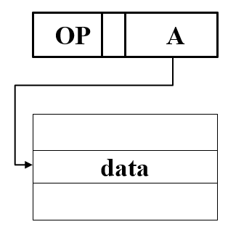
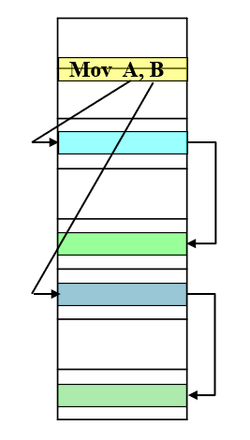
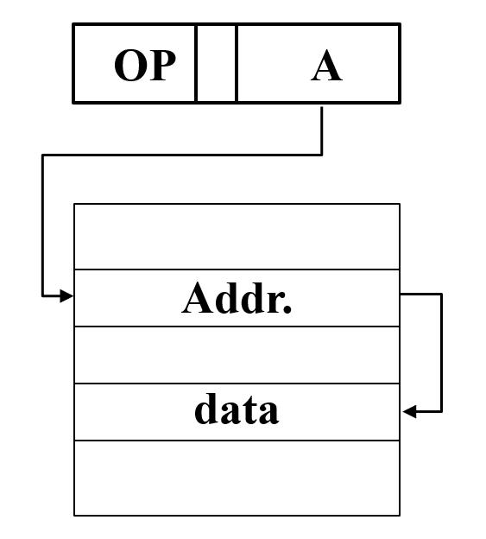
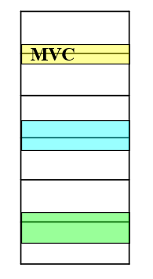
9.5 Allocation of Frames
指令系统 https://zhuanlan.zhihu.com/p/266763376
指令的组成与格式 https://zhuanlan.zhihu.com/p/357419709
Each process needs minimum number of pages.
Example:
All memory reference instructions have only one memory address, needs at least 2 frames per process.
If one-level indirect addressing is allowed, requires at least 3 frames per process.
Move instruction, PDP-11, needs 6 pages
instruction itself may straddle 2 pages.
each of its two operands may be indirect references.
MVC instruction, IBM 370, needs 6 pages:
instruction is 6 bytes, might straddle 2 pages.
2 pages to handle from block.
2 pages to handle to block.
Two major allocation schemes
fixed allocation
priority allocation

Slide 53
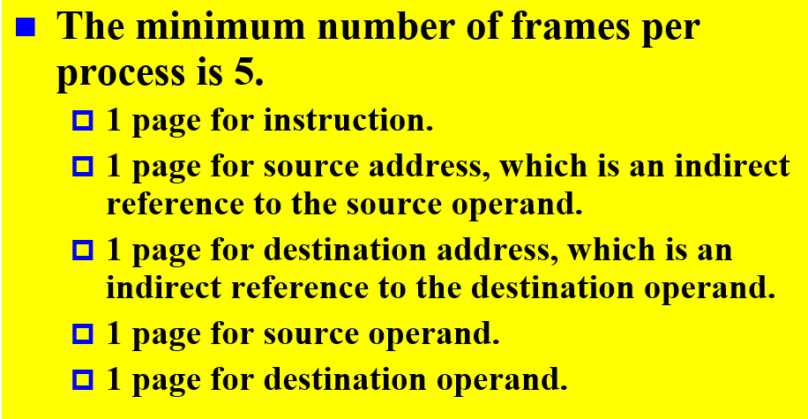
Exercise 7
Consider a machine in which all memory-reference instructions have two memory addresses, and one-level indirect addressing is allowed; if an instruction is assumed to be stored in only one frame, then the minimum number of frames per process is . And briefly why?
op
D
S
D-addr
S-addr
D-datar
S-data

Slide 54
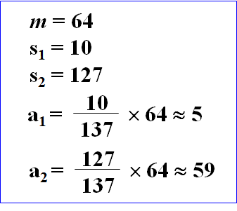
Allocation of Frames： Fixed Allocation
Equal allocation – e.g., if 93 frames and 5 processes, give each 18 frames, 3 leftover frames used as a free-frame buffer pool.
Proportional allocation – Allocate available memory to each process according to its size.
s_{i}: size of virtual memory for process p_{i}
S=∑s_{i}
m: total number of frames
a_{i}: allocation for process p_{i} a_{i}= s_{i}/S × m
Adjust each a_{i} to be a integer greater than its minimum number of frames, with the sum not exceeding m.
Allocation may vary according to the multiprogramming level.
when a page fault occurs, one of the pages of that process must be replaced. -- Local replacement

Slide 55
Allocation of Frames： Priority Allocation
Use a proportional allocation scheme using priorities rather than size, or on a combination of size and priority.
Dynamic as degree of multiprogramming, process sizes change.
If process P_{i} generates a page fault,
select for replacement one of its frames. Local replacement
select for replacement a frame from a process with lower priority number. Global replacement

Slide 56
Global vs. Local replacement
Global replacement
selects a replacement frame from the set of all frames; one process can take a frame from another.
easiest to implement, commonly used method.
operating system keeps list of free frames.
free frame is added to resident set of process when a page fault occurs.
problem: a process cannot control its own page-fault rate.
Local replacement
selects page from among the resident set of the process that suffers the fault.
The set of pages in memory for a process is affected by the paging behavior of only that process.
Global replacement results in greater system throughput.

Slide 57
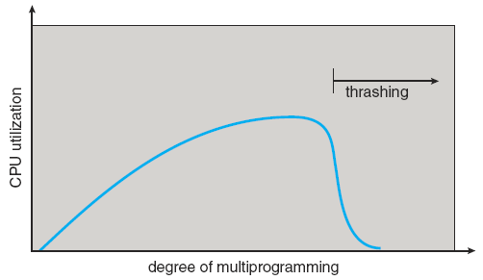
9.6 Thrashing
内存过度分配
最小需求无法满足
If a process does not have “enough” pages, the page fault rate is very high.
Page fault to get page
Replace existing frame
But quickly need replaced frame back
This leads to:
Low CPU utilization.
OS thinks that it needs to increase the degree of multiprogramming.
Another process added to the system.
This high paging activity is called thrashing.
A process is thrashing if it is spending most time paging than executing.
must decrease the degree of multiprogramming.

Slide 58
Thrashing
Why does thrashing occur?
Σ locality size > total memory size
using a local (or priority) replacement algorithm, Can limit the effect of thrashing.
To prevent thrashing, must provide a process with as many frames as it needs.
How to know how many frames it "needs"?
looking at how many frames a process is actually using.
Locality model of process execution
Locality: a set of pages that are actively used together. Localities are defined by the program structure and data structure.
Process migrates from one locality to another. e.g. function call.
Localities may overlap.

Slide 59
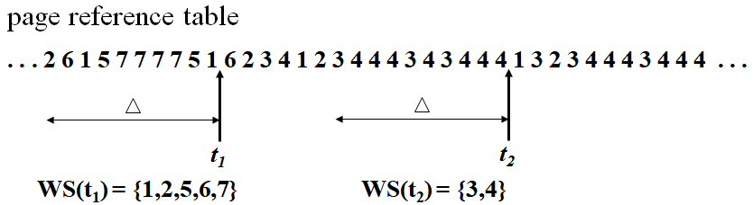
Working-Set Model
Δ ≡ working-set window ≡ a fixed number of page references.
Example: 10,000 instruction
Working Set: the set of pages in the most recent Δ page references.
WSS_{i} (Working Set Size of Process P_{i}) : (varies in time) the number of pages in Working Set of process P_{i}.
The accuracy of the working set depends on the selection of Δ.
if Δ too small? if Δ too large? if Δ = ∞

Slide 60
Working-Set Model
WSS_{i} -- process i needs WSS_{i} frames.
D = ΣWSS_{i} ≡ total demand frames
Approximation of locality
if D > m (available frames) ⇒ Thrashing
OS monitors the working set of each process.
if D > m, then suspend one of the processes.
difficulty: keeping track of the working set.

Slide 61
Working-Set Model
keeping track of the working set:
Approximate with interval timer + a reference bit
E.g : Δ = 10,000 references
Timer interrupts after every 5000 time units.
Keep 2 in-memory bits for each page.
Whenever a timer interrupts, copy and set the values of all reference bits to 0.
If one of the bits in-memory = 1 ⇒ page in working set.
Why is this not completely accurate?
Improvement: increasing the number of history bits and the frequency of interrupts.
E.g: 10 history in-memory bits and interrupt every 1000 time units.

Slide 62
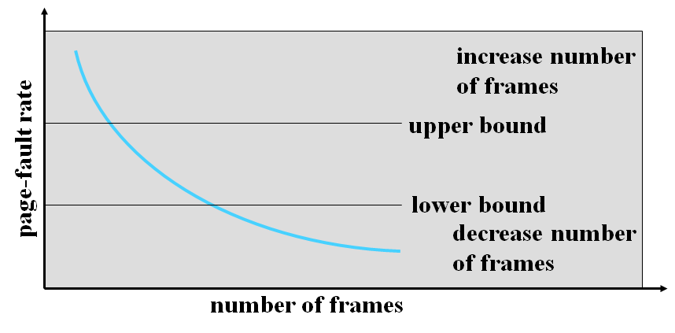
Page-Fault Frequency Scheme
More direct approach than Working-Set Model.
page-fault frequency (PFF) : Establish "acceptable" page-fault rate and use local replacement policy.
If actual rate is too low, process loses frame.
If actual rate is too high, process gains frame. Select some process and swap it out to backing store.

Slide 63
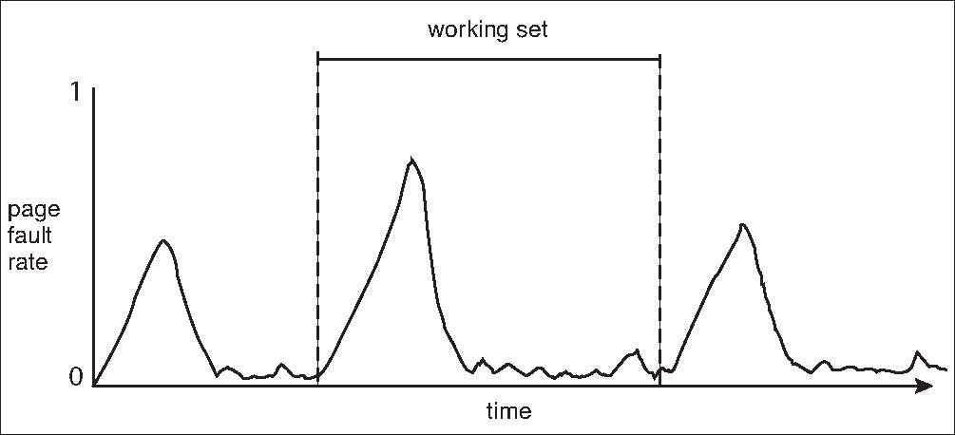
Working Sets vs. Page Fault Rates
Working set changes over time. Peaks and valleys over time.

Slide 64
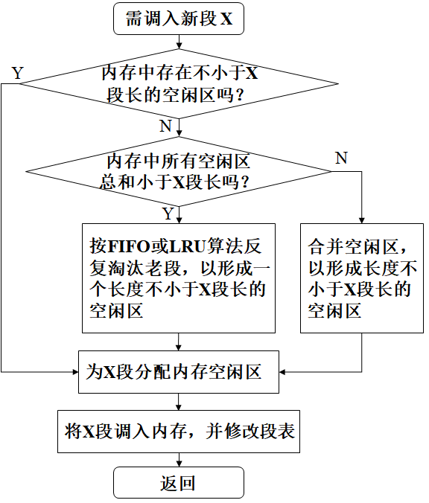
缺段中断及处理
Demand segmentation
当CPU要访问的指令/数据不在内存中时，产生“缺段中断”。
segment table
valid-invalid bit
OS捕获中断，并调用相应的中断处理程序，进行处理。
缺段处理过程：

Slide 65
9.7 Memory-Mapped Files
Memory-mapped file I/O allows file I/O to be treated as routine memory access by mapping a disk block to a page in memory.
A file is initially read using demand paging.
A page-sized portion of the file is read from the file system into a physical frame.
Subsequent reads/writes to/from the file are treated as ordinary memory accesses.
Simplifies and speeds up file access by treating file I/O through memory rather than read() and write() system calls.
When does written data make it to disk?
Periodically, e.g, when the pager scans for dirty pages.
at file close() time.

Slide 66
Memory-Mapped File
Some Oses, memory mapping only through a specific system call.
Some Oses, choose to memory-map a file. (Solaris)
Process explicitly request memory mapping a file via mmap() system call.
File is mapped into process address space.
For standard I/O (open(), read(), write(), close())
File is mapped to kernel address space.
Process still does read() and write()
Copies data to and from kernel space and user space
Uses efficient memory management subsystem.

Slide 67
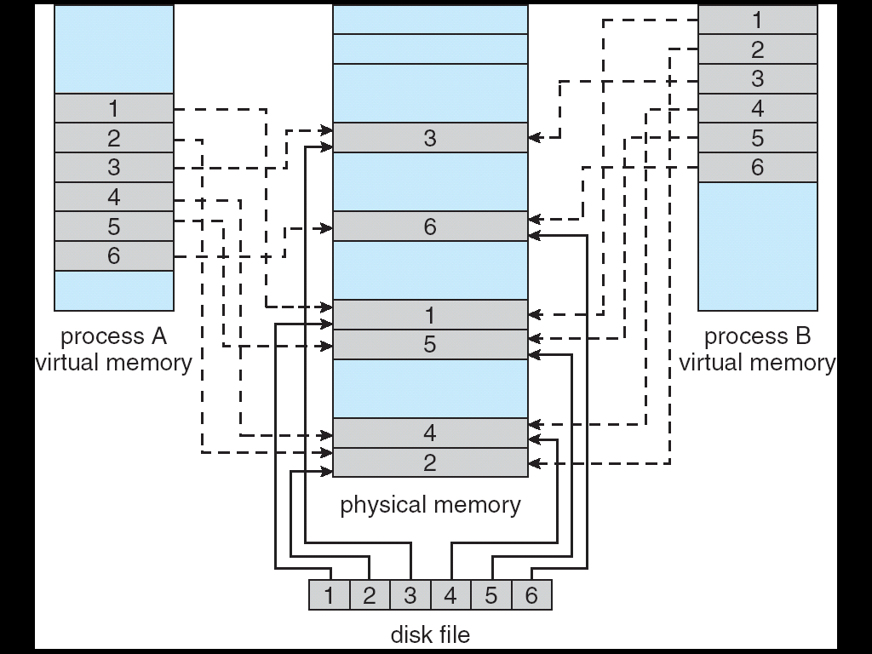
Memory-Mapped Files
Allows several processes to map the same file concurrently, allowing the pages in memory to be shared.

Slide 68
Memory-Mapped Files
COW can be used for read/write non-shared pages.
allowing processes to share a file in read-only mode but to have their own copies of any data they modify.
Memory mapped files can be used for shared memory.

Slide 69
Shared Memory in Windows API
First create a file mapping for the file to be mapped.
Then establish a view of the mapped file in process’s virtual address space
Consider producer / consumer
Producer create shared-memory object using memory mapping features.
Open file via CreateFile(), returning a HANDLE.
Create mapping via CreateFileMapping() creating a named shared-memory object.
Create view via MapViewOfFile().
Sample code in Textbook (P.351-352)

Slide 70
Memory-mapped I/O
ranges of memory addresses are set aside and are mapped to the device registers.
Reads and writes to these memory addresses cause the data to be transferred to and from the device registers.
appropriate for devices that have fast response times, such as video controllers. e.g. IBM PC, each location on the screen is mapped to a memory location.
also convenient for other devices, such as the serial and parallel ports used to connect modems and printers to a computer.
The CPU transfers data through these kinds of devices by reading and writing a few device registers, called an I/O port.

Slide 71
9.8 Allocating Kernel Memory
Treated differently from user memory .
Kernel memory is often allocated from a free-memory pool different from the list used to satisfy ordinary user-mode processes. Reasons are:
Kernel requests memory for data structures of varying sizes, some of which are less than a page in size.
Some kernel memory needs to be contiguous. i.e. for device I/O Certain hardware devices interact directly with physical memory, and may require memory residing in physically contiguous pages.
Buddy system
Slab allocation

Slide 72
Buddy System (伙伴系统）
Allocates memory from a fixed-size segment consisting of physically contiguous frames.
Memory is allocated by using a power-of-2 allocator.
Satisfies requests in units sized as power of 2.
Request rounded up to next highest power of 2.
Entire space available is treated as a single block of 2^{U}
If a request of size s such that 2^{U-1} < s <= 2^{U}, entire block is allocated, Otherwise block is split into two equal buddies.
Process continues until smallest block greater than or equal to s is generated.

Slide 73
Buddy System
E.g. 256KB chunk available, kernel requests 21KB
Split into A_{L} _{and} A_{R} of 128KB each.
One further divided into B_{L} and B_{R} of 64KB each
One further divided into C_{L} and C_{R} of 32KB each
One used to satisfy request.
Advantage – quickly coalesce unused (buddy) chunks into larger chunk.
Disadvantage – internal fragmentation

Slide 74
Buddy System，example
1MB block
A: Request 100KB
B: Request 240KB
C: Request 64KB
D: Request 256KB
Release B
Release A
E: Request 75KB
Release C
Release E
Release D
256KB
256KB
128KB
A
E
512KB
128KB
64KB
C
64KB
256KB
B
256KB
D
1MB
512KB

Slide 75
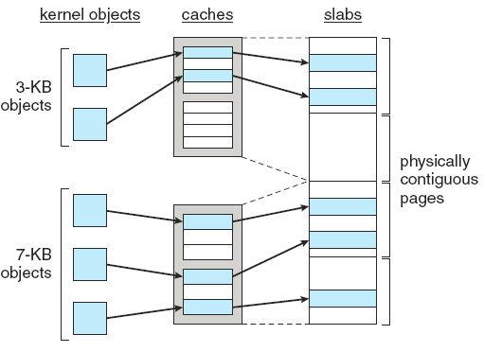
Slab allocation
A slab is made up of one or more physically contiguous pages.
A cache consists of one or more slabs.
There is a single cache for each unique kernel data structure, e.g. PCBs, semaphores.
Each cache is filled with objects,
instantiations of the kernel data structure.
When cache created, filled with objects marked as free.
The number of objects in the cache depends on the size of the associated slab.
When structures stored, objects marked as used.
If slab is full of used objects, next object allocated from empty slab.
If no empty slabs, new slab allocated.
Benefits: no fragmentation, fast memory request satisfaction

Slide 76
Slab Allocator in Linux
For example process descriptor is of type struct task_struct, approx 1.7KB of memory.
New task → allocate new struct from cache
Will use existing free struct task_struct
Slab can be in three possible states
Full – all used
Empty – all free
Partial – mix of free and used
Upon request, slab allocator
Uses free struct in partial slab
If none, takes one from empty slab
If no empty slab, create new empty slab and assigned to a cache, memory is allocated from this slab.

Slide 77
Slab Allocator in Linux
Slab started in Solaris 2.4, now wide-spread for both kernel mode and user memory in various OSes
Linux 2.2 had SLAB, now has both SLOB and SLUB allocators
SLOB for systems with limited amount of memory.
Simple List of Blocks, maintains 3 lists of objects for
Small objects, objects<256B
medium objects, objects<1024B
large objects, objects<page size
Memory requests are allocated from an object on an appropriately size list using first-fit policy.
SLUB is now the default allocator, performance-optimized SLAB
Moves the metadata stored with each slab to the page structure for each page.
Removes per-CPU queues for objects in each cache.

Slide 78
9.9 Other Considerations
Prepaging
Page Size
TLB Reach
Inverted Page Tables
Program Structure
I/O interlock

Slide 79
Prepaging
To reduce the large number of page faults that occurs at process startup or a swapped-out process resatart.
Prepage all or some of the pages a process will need, before they are referenced.
if prepaged pages are unused, I/O and memory was wasted.
Prepaging may be an advantage in some cases.
whether the cost of using prepaging is less than the cost of servicing the corresponding page faults.
Example
S pages are prepaged
a fraction α of these S pages is actually used (0<α<1)
the cost of the S ×α saved page faults is greater or less than the cost of prepaging S × (1 -α ) unnecessary pages.
if α is close to 0, prepaging loses; if α is close to 1, prepaging wins.

Slide 80
Page size selection
Page size ranging from 4KB to 4MB.
size of the page table
each active process must have its own copy of the page table, a large page size is desirable.
fragmentation
to minimize internal fragmentation, small page size is needed.
I/O overhead
I/O time = seek time + latency time + transfer time
seek and latency time normally dwarf transfer time
to minimize I/O time, large page size is desired
locality
with a small page size, locality will be improved, total I/O should be reduced.
to minimize the number of page faults, a large page size is need.

Slide 81
TLB Reach
The amount of memory accessible from the TLB.
TLB Reach = (TLB Size) × (Page Size)
Ideally, the working set of each process is stored in the TLB.
Otherwise, there is a high degree of page faults.
process will spend a considerable amount of time resolving memory references in the page table rather than TLB.
Increasing the Size of the TLB reach by
Increase the Page Size. This may lead to an increase in fragmentation, as not all applications require a large page size.
Provide Multiple Page Sizes. This allows applications that require larger page sizes to have the opportunity to use them without an increase in fragmentation.

Slide 82
Example Page Sizes
Computer | page size
Atlas | 512 48-bit words
Honeywell-Multics | 1024 36-bit words
IBM370/XA and 370/ESA | 4 Kbytes
VAX family | 512 bytes
IBM AS/400 | 512 bytes
DEC Alpha | 8 Kbytes
MIPS | 4 Kbytes to 16 Mbytes
UltraSPARC | 8 Kbytes to 4 Mbytes
Pentium | 4 Kbytes to 4 Mbytes
PowerPC | 4 Kbytes

Slide 83
Inverted Page Tables
Purpose: to reduce the amount of physical memory needed to track virtual-to-physical address translations.
has one entry per frame of physical memory.
indexed by the pair <process-id, page-number>.
keep information about which virtual memory page is stored in each physical frame.
When page faults, other information required.
e.g on where each virtual page is located, the number of pages.
An external page table (one per process) must be kept.
Be paged in and out of memory as necessary.
A page fault may now cause the virtual memory manager to generate another page fault to page in the external page table it needs.

Slide 84
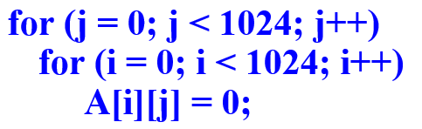
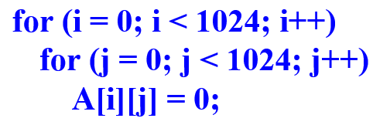
Program structure
Page size = 1024 words
int A[ ][ ] = new int[1024][1024];
Each row is stored in one page
The OS allocates fewer than 1024 frames to the entire program
Program 1:
Program 2
1024 × 1024 page faults
1024 page faults

Slide 85
Program structure
Careful selection of data structures and programming structures can increase locality, and hence lower the page-fault rate and the number of pages in the working set. e.g.
A stack has good locality, since access is always made to the top.
A hash table is designed to scatter references, producing bad locality.
compiler and loader have a significant effect on paging.
Separating code and data and generating reentrant code means that code pages can be read-only, and will never be modified.
Clean pages do not have to be paged out to be replaced.
loader can avoid placing routines across page boundaries
keeping each routine completely in one page.
Routines that call each other many times can be packed into the same page.

Slide 86
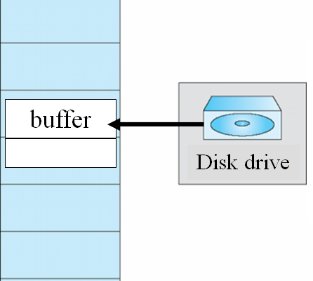
I/O Interlock and page locking
Sometimes pages must be locked into memory.
Consider pending I/O.
Pages that are used for I/O from a device must be locked from being selected for eviction by a page replacement algorithm.
Never to execute I/O to user memory.
Data are copied between system memory and user memory.
I/O takes place only between system memory and I/O device.
Allow pages to be locked into memory.
A lock bit is associated with every frames.
Locked page cannot be replaced
When I/O complete, unlocked.
Pinning of pages to lock into memory.

Slide 87
I/O Interlock and page locking
Some or all of the OS kernel is locked into memory.
User processes may need to lock pages into memory.
Consider: system with demanding paging, priority scheduling, global replacement.
A low-priority process L faults.
OS selecting a replacement frame, and paging the necessary page in.
Then, L enters the ready queue. It may not be selected for a long time.
While L waits, a high-priority process H faults.
Looking for a victim, it is the page that L just brought in -- clean and has not been used for a long time.

Slide 88
I/O Interlock and page locking
Use the lock bit, to prevent replacement of a newly brought-in page until it can be used at least once.
When a page is selected for replacement, its lock bit is turned on.
Lock remains on until the faulting process is again dispatched.
Most OSes have a system call allowing an application to request a region of its logical address space be pinned.
Dangerous: lock bit may get turned on but never turned off.
Locked frame becomes unusable.

Slide 89
9.10 Operating System Examples(*)
Windows
demand paging with clustering
maintains a list of free frames and a threshold value
Processes: working set minimum and maximum.
At working set maximum, using local LRU policy
clock / FIFO algorithm, up to the type of processor
Solaris
demand paging
Maintains a list of free pages
Maintains a cache list of pages that have been "freed" but have not yet been overwritten
second chance algorithm, two-hand clock

Slide 90

课后作业及研究性学习
作业
内存中逻辑地址到物理地址的转换
比较不同的内存管理模式
实验
编码实现页面置换算法
研究性学习
国产内存产品调研，撰写调研报告
A3: openEuler
按需调页
A4: openEuler
页面交换
A5: openEuler
buddy

Slide 91
A1：openEuler COW
fork()创建的新进程与父进程有着完全一样的地址空间，这可以用两种方案来实现。
给新进程分配与父进程等量的物理内存，并把父进程在内存中的所有数据都给新进程复制一份
分配物理页作为新进程的页表；
复制父进程页表内容；
对照父进程页表，为新进程页表项分配物理页并建立映射关系；
将父进程的物理页内容复制到新进程相应页中。
openEuler: （copy on write） 在新进程中建立与父进程同样的映射关系，让两个进程以只读的形式共享同一片物理内存，直到某个进程试图修改某一页内容时，再为其分配新的物理页并复制原页面内容，这被称作写时复制

Slide 92
COW in openEuler

Slide 93
COW in openEuler
在页表复制过程中，还需要将用户空间中支持写时复制的物理页都标记为只读（Read Only），任意一方想写入内容都会触发缺页异常，请求内核来处理这种情况。
内核：需要确认该缺页异常是由于写时复制引起的，之后内核会将触发缺页异常的只读物理页内容复制到一个新的可读写物理页中，并在当前进程页表中的映射关系中用新页替换旧页。

Slide 94
关键技术
复制映射关系
所有进程的内核空间都是相同的。不同进程的用户空间可以不同，所以函数fork()需要为新进程的每一级页表分配物理页，并从父进程对应页表中复制所有页表项。
将物理页标记为只读，确保父进程与新进程都不能随意地修改其内容，这可以通过修改PTE页表项的权限位实现。
每个进程指向内核空间的页表都是相同的，所以只需修改用户空间部分的PTE页表项权限位。
针对当前页表项，如果判定其最终指向的物理页不属于共享可写页，即支持写时复制映射，就会对父进程与新进程的当前PTE页表项进行写保护： 先清除可写权限，再设成只读权限。
任何一方在执行过程中尝试去向该表项指向的物理页写入内容都会触发缺页异常，避免直接修改共享页内容影响到其他进程。

Slide 95
关键技术
写时复制触发的缺页异常处理
异常处理器，先进行访问权限判断，对于进程权限不足导致的缺页异常返回一个错误信号给进程，而不做其他处理。
接着，判断PTE页表项是否为空，如果不为空，说明其确实映射着一个物理页。若此物理页仍在内存中，再做进一步判断，否则会请求从外存中将物理页换入。
然后，通过标志FAULT_FLAG_WRITE确定缺页异常是由写访问触发的，若PTE页表项的标志位PTE_WRITE也未置位，表明此页确实不可写。
至此，异常处理器可以断定缺页异常是由对写时复制页面执行写操作导致的，进入相应的处理函数。

Slide 96
关键技术
确定了缺页异常是由写时复制引起后，又存在两种情况：
第一，当前有两个及以上的进程以只读形式共享该页
由于在原只读共享页上是不允许进程执行写操作的，异常处理器必须为其分配一个新的可写物理页。
新页需要复制触发缺页异常的旧页内容。需要用新页替换掉触发异常的只读页与新进程页表的映射关系： 先将新页地址保存在一个临时的PTE页表项，再把临时PTE页表项权限位设为可读可写，最后用临时PTE页表项内容覆盖新进程页表中原页表项内容。
这样，进程的写操作变成了分配新的物理页，不会再影响到原来的共享页。
第二，当前仅有一个进程在使用这个页面，即其他进程因写操作已取消与该页的映射关系。
异常处理器只需要将页面的只读权限改为可读写即可。

Slide 97
A2: vfork()
pid_t vfork(void);
所需头文件：
#include <sys/types.h>
#include <unistd.h>
功能：
vfork() 函数和 fork() 函数一样，都是在已有的进程中创建一个新的进程，但它们创建的子进程是有区别的。
参数：无
返回值：
成功：子进程中返回 0，父进程中返回子进程 ID。
失败：返回 -1。
区别1：
fork()：父子进程的执行次序不确定。
vfork()：保证子进程先运行，在它调用 exec或 exit之后父进程才可能被调度运行。
区别2：
fork()：子进程拷贝父进程的地址空间，子进程是父进程的一个复制品。
vfork()：子进程共享父进程的地址空间（准确来说，在调用 exec 或 exit 之前与父进程数据是共享的）。

Slide 98
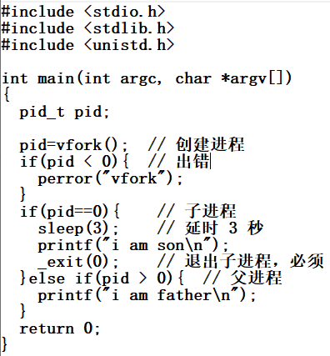

vfork()

Slide 99
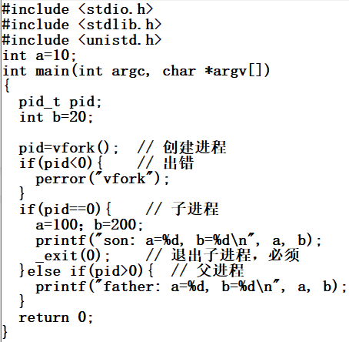

vfork()

Slide 100
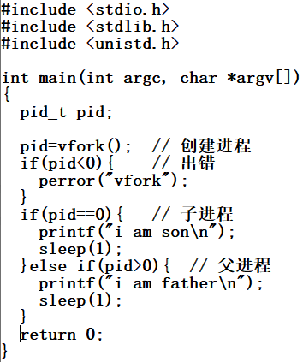
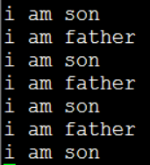
vfork()
用 vfork() 创建进程，子进程里一定要调用 exec() 或 exit()，否则，程序会出问题，没有意义。

Slide 101
A3: openEuler 按需调页
openEuler demand paging
openEuler 结构体vm_area_struct
Page fault处理—硬件部分
Page fault处理—操作系统部分

Slide 102
openEuler demand paging
假设openEuler在加载进程时，只加载从虚拟地址0开始的4KB内容
依次为PGD、PMD和PT分配一个frame，并初始化相关表项
将PGD的地址保存在结构体mm_struct的成员pgd中，用于上下文切换时为页表基址寄存器赋值；
将PGD的第0项PGDE初始化为表描述符形式，并设置其“下一级页表”字段指向PMD所在frame；
将PMD的第0项PMDE初始化为表描述符形式，并设置其“下一级页表”字段指向PT所在frame；
分配以恶搞frame用来装载进程信息，并将PT的第0项PTE设置为块描述符形式，并设置其“输出地址”字段指向新分配的frame。

Slide 103
openEuler 结构体vm_area_struct
记录一个虚拟地址段的信息
成员vm_start：虚拟地址段的起始地址
成员vm_end：虚拟地址段的结束地址
成员vm_file：映射到的文件信息
一个进程的所有虚拟地址段的描述组织成一个双向链表。
openEuler根据可执行文件的ELF头部信息为进程建立若干虚拟地址段结构体，填写其中的起始地址和结束地址，并将程序的可执行文件信息保存在成员vm_file中。

Slide 104
Page fault处理—硬件部分
CPU自动将异常类型级原因分别保存在寄存器ESR_EL1的EC字段和ISS字段。
触发异常的虚拟地址保存在寄存器FAR_EL1中。
内存访问异常：
数据异常（编号：0x24）
指令异常（编号：0x20），具体原因：
访问权限错误、转换错误等
CPU读取VBAR_EL1获得异常向量表地址，自动跳转到异常向量表偏移地址为0x400（el0同步异常）的位置开始执行。

Slide 105
Page fault处理—操作系统部分
el0_sync处理流程
读取寄存器ESR的EC字段，获得异常类型，以进一步选择异常分支；
数据/指令异常处理函数el0_da/el0_ia进行一些必要的参数（异常地址、寄存器ESR的值，用户进程各寄存器终态）初始化，以传递给C语言函数do_main_abort()。

Slide 106
Page fault处理—操作系统部分
Do_main_abort()
区分发生数据/指令异常的原因，选择不同的处理分支。
结构体fault_info，异常编号：处理函数地址，如： L3级页表访问中发现无效PTE，ISS=ox7，处理函数“level 3 Transaction Fault”的地址。
函数“level 3 Transaction Fault”的执行，将缺少的信息加载到内存中。
需要先进行一些必要的页表设置操作

Slide 107
Page fault处理—操作系统部分
缺页时页表的建立（示例）
页大小：4KB，PTE大小：8B
访问虚拟地址：[2MB:2MB+4KB]
PGD[0]→PMD[1]→PT[1]
假设遍历L2级页表时发现PMD[1]无效
完成第（1）步： 分配一个frame，保存PT块，将该frame编号写入PMD[1]；
访问该PT块的PT[1]，发现无效，完成第（2）步：分配一个frame，根据该可执行文件的文件名，从文件系统中把所缺的内容读入物理内存。
openEuler采用ext4文件系统管理文件，调用函数ext4_filemap_fault()读取文件内容。

Slide 108
Page fault处理—操作系统部分
ext4_filemap_fault()
根据可执行文件名获得记录该文件信息的inode节点
对该inode节点加锁
调用函数filemap_fault()
根据虚拟地址相对于虚拟地址起始地址的偏移量获得所缺内容在可执行文件中的偏移量
为待加载内容分配一个frame
将待加载内容装入该frame
设置该虚拟地址对应的页表项PT[1]，使之指向该frame。

Slide 109
A4: openEuler页面交换
openEuler page out
openEuler page in
openEuler 页面置换
openEuler 内存回收

Slide 110
openEuler page out
同步内存回收：当系统中没有可供分配的空闲frame时，OS在内存分配函数中同步调用页回收过程。
异步内存回收：系统运行时对内存进行周期性检查，当空闲frame数量下降到page_low以下时，系统唤醒kswapd进程来主动回收frame.

Slide 111
openEuler page in
PTE终态：
空，page还未分配空间，从文件系统调入（do_fault()），或为匿名页分配空间（do_anonymous_page()）；
非空，swp_PTE，从交换区调入（do_swap_page()）。

Slide 112
openEuler 页面置换
LRU
5个链表
非活跃匿名页LRU链表：所有最近没被访问的、并且可以存放到交换空间的匿名页的记录；
活跃匿名页LRU链表：所有最近被访问过的匿名页的记录；
非活跃文件页LRU链表：最近没被访问过的文件页的记录；
活跃文件页LRU链表：所有最近被访问过的文件页的记录；
不可回收LRU链表：所有禁止换出的页的记录。
用户程序，安全性要求高，希望敏感数据不被换出， 因为：程序结束后，攻击者可能访问交换空间以恢复数据。

Slide 113
openEuler 内存回收
从非活跃链表末尾开始选择多个记录回收。
在非活跃LRU链表中的页，更有可能优先被奥做系统回收。
进程请求新页时，根据不同的页类型（匿名页或文件页），把这个页的记录加入到不同的活跃LRU链表中。
堆和栈使用的新的匿名页，加入活跃匿名页链表中；
共享内存页，加入非活跃匿名链表中；
程序代码段对应的文件页，加入活跃文件页链表中；
进程打开的文件对应的文件页，加入到非活跃文件页链表中；
若该页未被修改，可以直接淘汰。

Slide 114
openEuler 内存回收
匿名页的回收
当非活跃LRU链表中的页记录数量过少时，openEuler将从活跃LRU链表尾部向前扫描，移动一些页记录（通常为32个）到非活跃链表头部；
操作系统更新非活跃匿名页LRU链表。
操作系统从非活跃匿名页LRU链表尾部开始向前扫描32个页记录，堆不同状态的页进行不同的处理：
最近访问过的页，将页记录移动到活跃匿名页LRU链表尾部，并清零其PTE中的访问标志；
最近未访问的页，尝试进行回收。

Slide 115
openEuler 内存回收
文件页的回收
流程类似于匿名页的回收。
不同：
匿名页使用地址访问，系统自动记录页被访问过（PTE）。
对文件页的访问记录，openEuler引入了一个新的页标识PG_reference，当该页被访问，置1.
大部分文件页的访问是通过read()和write()函数调用访问。
OS需要在文件操作的代码中显式地置位文件页的PG_reference。
文件系统在管理缓冲区时，函数touch_buffer()会调用函数mark_page_accessed()设置PG_reference标识位。

Slide 116
A5: openEuler buddy
openEuler中虚拟地址空间布局
openEuler中的buddy系统
Buddy系统初始化
Frame块的分配
Frame块的回收

Slide 117
openEuler中虚拟地址空间布局
2³⁹B
2³⁹B

Slide 118
openEuler中的buddy系统
Buddy系统中两个i阶frame块为伙伴关系，需要满足两个条件
两个frame块的大小相同，且物理地址连续
将两个i阶的frame块合并为一个i+1阶的frame块后，第一个frame的编号必须为2^{i+1}的整数倍。

Slide 119
Buddy系统初始化
OS初始化时，会将连续的frame组织起来，并加入buddy系统。
函数__free_pages_bootmen()
每加入一个frame块，buddy系统都会检查它的伙伴是否存在，若存在，则合并为一个更大的frame块。
若没有连续的frame块，则将frame一个一个地第加入系统中。

Slide 120
Frame块的分配
请求m，2^{i-1}<m<2^{i}
（1）在free_area的第i个链表中分配空闲frame块
若有，则直接分配；// 结束返回
若没有，进行（2）
（2）查找第i+1个链表中是否有空闲的frame块
若有，则分配2^{i}个frame，将剩下的2^{i}个frame插入第i个链表中；
若没有，i=i+1,重复（2），直到找到有空闲frame块的链表。
假设在第i+x链表中找到空闲frame块，则将其分为L和R两半，将R加入第i+x-1链表中，将L继续分为L’和R’两半，将R’加入下一阶链表中，继续将L’分为两半，……，直到frame块大小为2^{i} ，将右半加入第i个链表，将左半分配。
若没有找到空闲的内存空间，则返回空值，分配失败。

Slide 121
Frame块的回收
回收空间2^{i} frame
查找第i个链表，看它的伙伴是否存在
不存在，直接插入第i个链表；
存在，从中取出其伙伴块，合并，并查找第i+1个链表，重复此过程，直到回收完成。
Buddy系统的优缺点
优点：简单、外部碎片较少、可分配连续的内存空间。
缺点：内存利用率较低，因为只有伙伴才可以合并。

